Slide 1
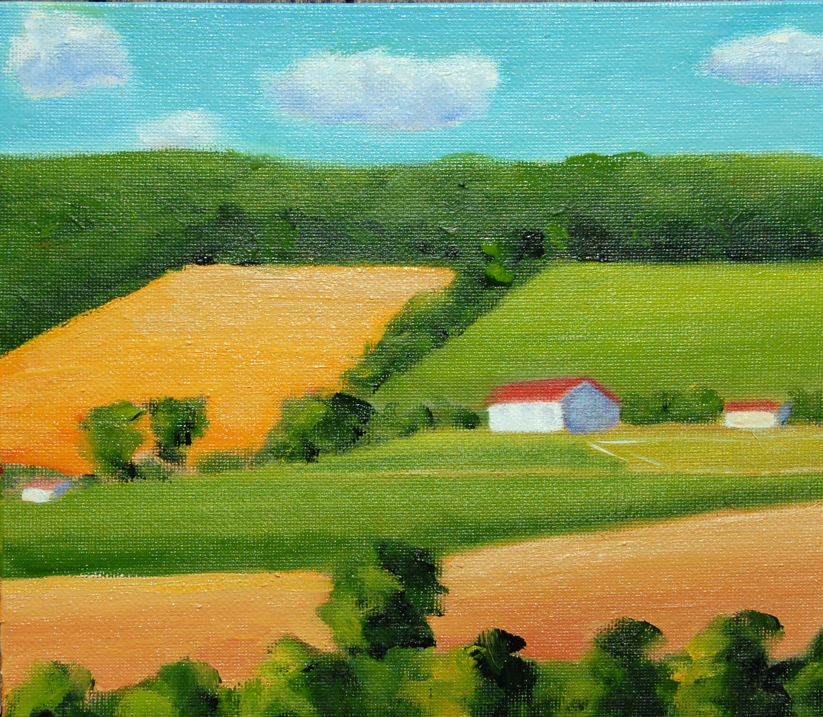
The Northeast food system
Opportunities & Challenges for Farm & Food Entrepreneurs
Jason R. Evans

Slide 2
Impacts ON the Food System
Culture: a population’s eating customs dictate—to some extent—what their food system produces.
Environment: Clearly, a population’s natural environment will restrict—to some extent—what its food system can produce.
Politics: government policy may favor one group of agricultural producers over another, thereby influencing what the food system produces
Economics: The huge variety and volume of products produced within the US food system has been made possible by the US having the largest economy in the world.
Notes:
Culture: In the US, the trend of veggie-forward diets (cauliflower pizza crusts; the “impossible” burger) WILL influence how our farmland is split between veggie production and meat production. In other parts of the world, religious and other cultural guidelines forbid consumption of certain meats, so naturally, those are NOT produced in those systems. Our custom of eating turkey at Thanksgiving fundamentally impacts the size and shape of the US poultry industry; on and on and on.
Environment: There are simply items that can’t grow in certain climate and soil conditions; this is why nearly all of the bananas, coffee and chocolate consumed in the US are imported—our system can’t grow them.
Politics: . For instance, for decades, MOST agricultural producer subsidies from the US federal government have gone to relatively LARGE grain (corn, wheat) and oilseed (soybean) producers. This gives these producers at least a slight economic advantage over fruit and veggie producers and has helped create an ag landscape in which MOST of our cultivated ag land in the US is used for grain and oilseed crops (corn, silage, soybeans and wheat make up 24% of our crop acreage; veggies and orchards make up only 1.3%)
Economics: Our population’s relatively high incomes mean that we can consume high volumes of products that are very expensive to produce including dairy, fruit, veg and meat. In poorer countries, food systems are dominated by crops that are much less expensive to produce like simple grains and starches (rice, cassava, potato).
In much of the world, POLITICS and ECONOMICS are highly intertwined and as such, they influence the food system in very complex ways. For instance, in the US, “social safety net” policies like the SNAP (Food Stamp) program provide $$ support for low-income families to buy food. This, of course, changes the ECONOMIC reality of many families and creates additional demand for food—thereby changing what and how much is produced in our food system.

Slide 3
Impacts OF the Food System
Culture: In so many ways, people ARE what they eat; our food system makes certain foods more or less expensive than others or more or less convenient than others.
Environment: All parts of the food system—including food production, harvesting, processing, packaging, distribution and consumption—impact natural resources in some way.
Politics: Because the design of our food system affects the prices that people pay for food, it also impacts how households experience poverty. If healthy food is relatively expensive, there is a role for policy to subsidize that food to achieve better health outcomes for the population.
Economics: Since the design and structure of the food system determines the prices of food, it directly impacts the amount of expendable income that people have for buying housing, transportation, education and other goods.
Notes:
Culture: SO, the system’s design determines what we eat, which then determines our weight, general health, quality of life and HOW we entertain and celebrate traditions.
Environment: These activities either use resources directly (fossil fuels, water, land) or produce residuals (pollution) that degrade resources (e.g., sediment and nutrient pollutants that destroy water habitats and greenhouse gas emissions from livestock and dairy operations that lead to climate change)
Politics:If all food is relatively expensive, more government income supports (minimum wage, SNAP, etc.) might be necessary to keep the population out of poverty.
Economics: SO, in a very real sense, a food system that is designed to produce HIGH volumes of food at low cost helps to keep a population out of extreme poverty.
By the same token, if a food system is designed such that certain foods—and in particular, unhealthy foods—are more convenient and affordable than others, this will lead to high healthcare costs that must in some way be borne by society (either out-of-pocket or through high taxes).

Slide 4
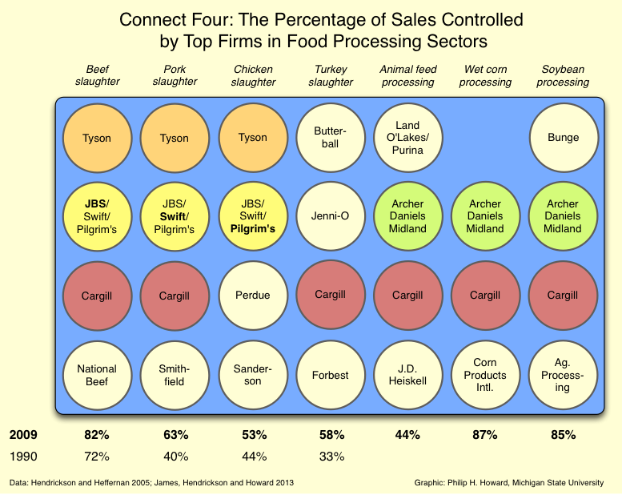
Conventional versus Alternative Food Systems
In the US, the “CONVENTIONAL” Food System is the system that
produces and delivers MOST (perhaps 90%) of the food that we eat.
“Commodity” production
Primarily made up of LARGE, consolidated, SPECIALIZED farm,
processing, shipping, wholesale and retail businesses
and multi-stage MARKETING CHANNELS
(meaning that product passes through SEVERAL
businesses from farm to plate)
Markets are HIGHLY competitive; low costs and
economies of scale are crucial for producer survival

Slide 5
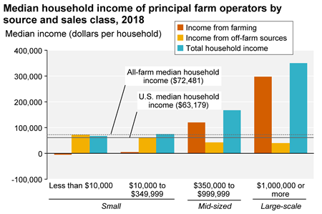

Slide 6
All Veggies = 0.3%
Orchards= 1%
Private Range/ Pasture = 58%

Slide 7
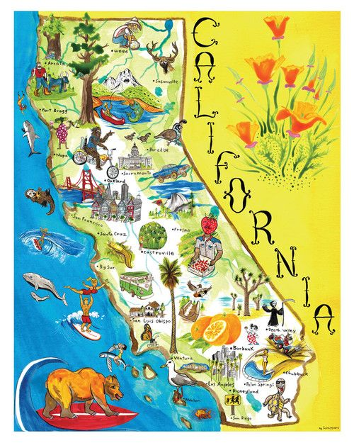
Total ag value, veggies, melon, potatoes, fruit, tree nuts, berries, nursery, greenhouse, floriculture, milk
(Second in sheep, goats, wool, rice
Third in livestock, poultry, cotton)

Slide 8
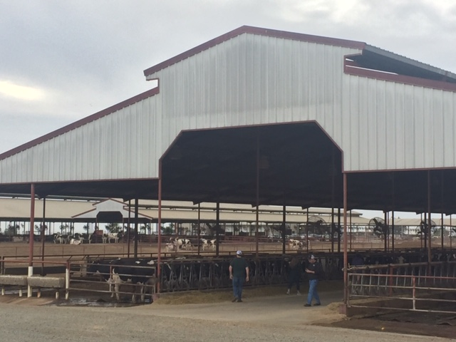
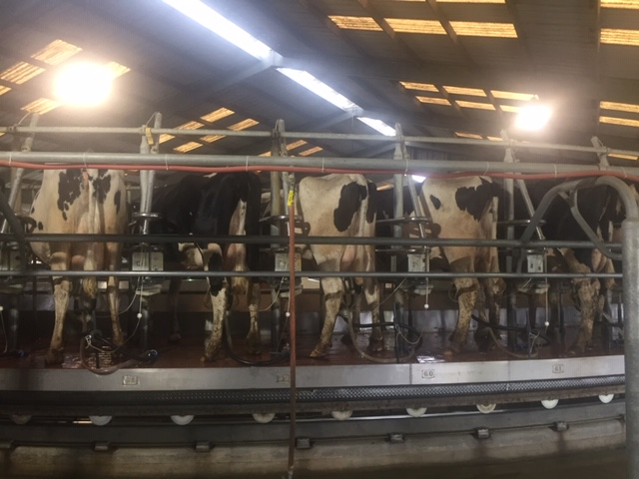
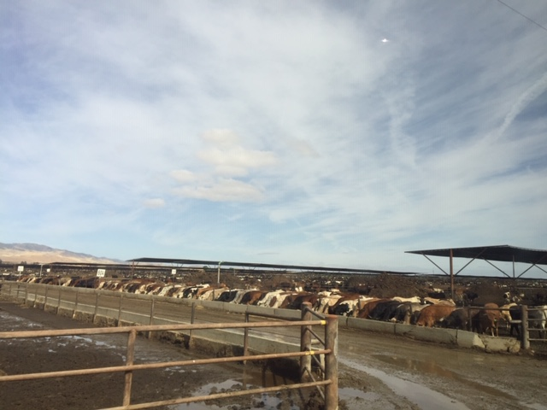
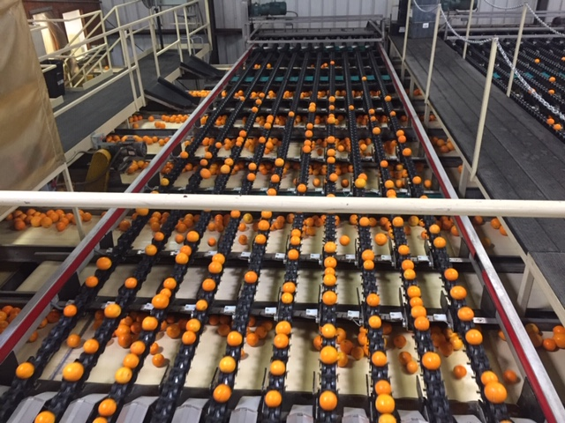
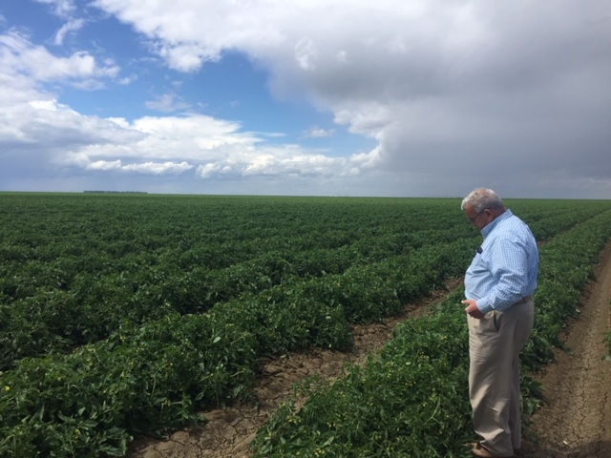
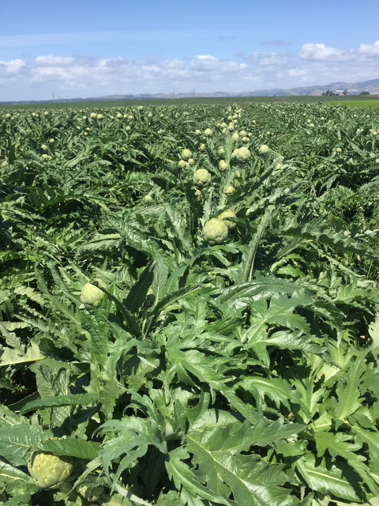
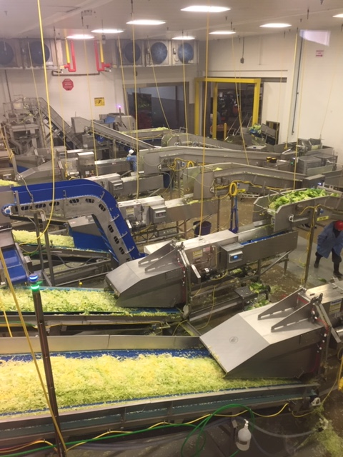
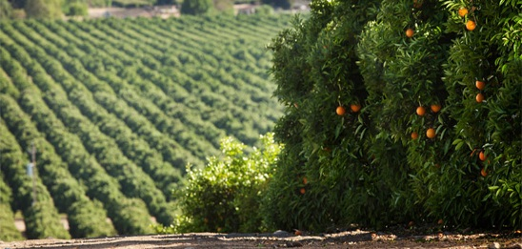
Elkhorn Dairy: 10,000 Cows
Harris Ranch Feeding: 100,000 Head
Red Rock Ranch: 4,000 acres of organic tomatoes and conventional melons
Taylor Farms: 77% market share in processed greens
Bee Sweet Citrus: 125 Trucks Daily
Ocean Mist Farms: Largest artichoke producer in North America

Slide 9
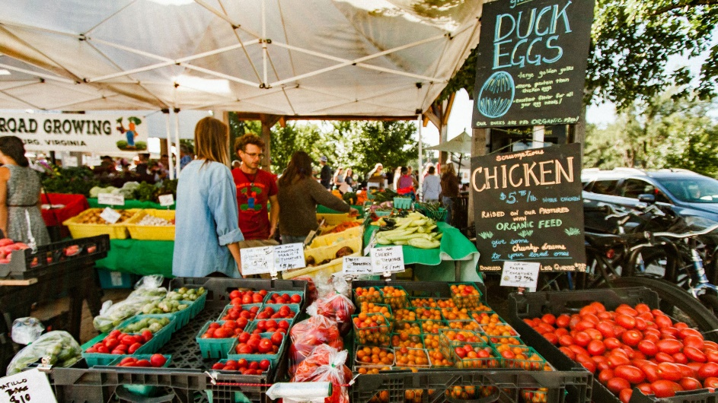
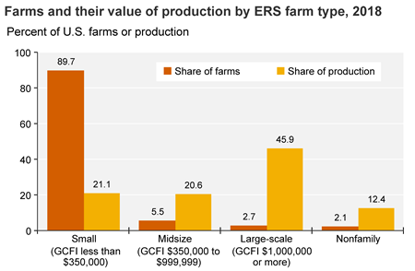
“Alternative” Food Systems are any other approaches to delivering food from farm-to-plate
E.g., vertically integrated farm producers who process, wholesale and retail their own products
Direct to consumer venues like farmers markets, roadside stands and CSAs
The “LOCAL” agricultural movement
Producers marketing differentiated production practices like “ORGANIC” or “NATURAL” or “GRASS-FED”
Typically involves SHORTER marketing channels than those in the conventional system (meaning that there are fewer players and a smaller number of transactions/changes in ownership)
The truth is, most farms in the U.S. are quite small and produce too little volume to really participate in the conventional food system; the alternative food system (farmers’ markets, direct sales to restaurants, on-farm processing, etc.) provides them opportunities to build legitimate businesses despite their inability to compete in the conventional system.

Slide 10
Northeast: The Challenges
Political uncertainty—trade and guest worker programs
Economies of scale possibilities with Northeast topography
Competition with year-round, multiple harvest grow seasons
Continued consolidation industry-wide
Regulatory and voluntary “certification” hurdles
Consumer “status quo” behaviors
Notes:
CAPPER VOLSTEAD ALLOWS IT!
If you know what your enterprise costs are and you’ve benchmarked, YOU KNOW WHERE YOU NEED WORK.
GETTING COSTS DOWN—ANY WAY YOU DO IT—OPENS UP NEW MARKETING OPPORTUNITIES—RESTAURANT, RETAIL, FOOD HUB

Slide 11
Northeast: The Opportunities
The advent and spread of online grocery shopping
New retail players with commitments to offering staple grocery items
The trend toward plant-forward diets and other chef-driven concepts
Proximity to metro consumer populations
Advances in CEA and other technologies
Consumer perception of “regional” versus “local” foods
(Slowly growing) investments in food system infrastructure

Slide 12
Northeast: The Needs
Business development and marketing assistance (FFBI—CADE & SUNY Cobleskill)
Virtual marketing/logistics infrastructure
Market intelligence
Physical food system infrastructure
Support of institutional buying

