Slide 1
NYSED Approved CTE Programs in Agriculture
Kelli Grab
Associate in Instructional Services, Agriculture
Career and Technical Education Office, NYSED

Slide 2
Discussion Points for Today
Career and Technical Education
NYSED Approved CTE programs
The Approval Process
Resources Available to You
Perkins Funding
Notes:
Put in chat: On a scale from 1 to 5 (1 being very unfamiliar and 5 being very familiar) how familiar would you say you are with the NYSED CTE program approval process?

Slide 3
Career and Technical Education Definition
Career and technical education (CTE) programs provide academic and technical instruction in the content areas of agriculture, business and marketing, computer science, family and consumer sciences, health sciences, trade and technical education, and technology education.
Approved programs lead to an industry-recognized credential, certificate or degree and offer:
an opportunity to apply academic concepts to real-world situations,
preparation for industry-based assessments or certifications;
the opportunity to earn college credit or advanced standing while still in high school; and
work-based learning opportunities where students demonstrate mastery of skills essential in the workplace.

Slide 4
NYSED CTE Approval
Having a NYSED approved CTE program allows your agriculture program to offer students a variety of benefits upon successful completion.
Technical endorsement
4+1 graduation pathway options
Integrated/specialized academic subject credit (distribution requirements)
Once initially approved, program approval lasts for a duration of 5 years upon which a re-approval process/application will need to be completed and submitted.

Slide 5
The Program Approval Process
The program approval process consists of two main components, the self-study and the external review.
The Self-Study can be described as the internal work that is done in creating and maintaining the approved program.
The External Review can be described as the industry representation or outside influence and support given to the creation and maintaining of the approved program.

Slide 6
The Self-Study
Guidelines for CTE Program Approval | New York State Education Department (nysed.gov)
Self-Study | New York State Education Department (nysed.gov)
The self- study team are the internal stakeholders that work to create the approved program pathway
Agriculture Teacher/s
Administrator/s
Guidance Counselor
Special Education Teacher
Academic Teachers (if offering academic credit within the program)
Program components the self-study team will oversee include:
Program Content
Work- Based Learning
Employability Profile
Articulation Agreement
Technical Assessment
Faculty
On each slide, the CTE resource document will be linked here for your reference and future use!

Slide 7
Program Content
Program Content | New York State Education Department (nysed.gov)
CFM Framework
Integrated and Specialized Academics | New York State Education Department (nysed.gov)
Program content consists of the coursework that will be part of the approved program. This is a major component that the self-study team will discuss.
Program content must meet the following criteria:
Increase in specificity
Include at least 3.5 units of coursework (3 CTE and .5 CFM)
Address both academic and technical knowledge and skills
Integrated and academic credit
Include 21st century skills as outlined in the Career and Financial Management (CFM) Framework
Align with needs of business and industry
Align to labor market data for your community or area

Slide 8
Program Content Examples
Some common CTE Agriculture programs include, but not limited to:
General Agriculture
Animal Science
Plant Science
Environmental Science
Veterinary Science
Agricultural Mechanics
Coursework
NYSED does not endorse any one curriculum or vendor, curriculum choices can be made by the district or program
*CASE is a very commonly used curriculum in NYSED Approved CTE programs, and their coursework does fit well into the CTE approval process.
Standards
Commonly used standards in NYSED approved CTE agriculture programs include AFNR, CCTC, and career or credential specific standards.

Slide 9
Work- Based Learning (WBL)
Work-Based Learning | New York State Education Department (nysed.gov)
An authentic learning experience that allow students to explore their career goals, abilities, and interests while applying their academic and technical knowledge and skills in a real-world context.
These experiences are planned and supervised by instructional staff in collaboration with business, industry, or community partners.
In a NYSED approved CTE program, WBL opportunities must be offered to students.
In the case of Perkins funding as well as the CDOS pathway to graduation, 54 hours of WBL must be completed by each student.
If your agriculture program has an FFA chapter and your students participate in SAE, this counts towards WBL offered to students in a NYSED approved CTE program!
This Photo by Unknown author is licensed under CC BY.

Slide 10
Employability Profile
Employability Profile | New York State Education Department (nysed.gov)
The employability profile is a tool developed to access the technical knowledge and skill students gain while completing CTE program.
Reflects the program of study and aligns with program content, skills acquired from work-based learning experiences, and skills from the technical assessment
Identifies technical knowledge and work-related skills as actionable tasks and practices that can be measured
Contains a clear rating scale with measurable indicators for student achievement
Identifies end of program outcomes, such as endorsements and/or licensure

Slide 11
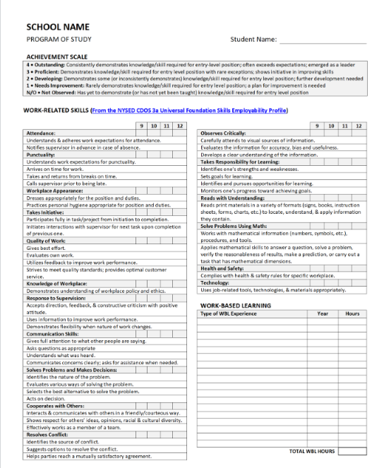
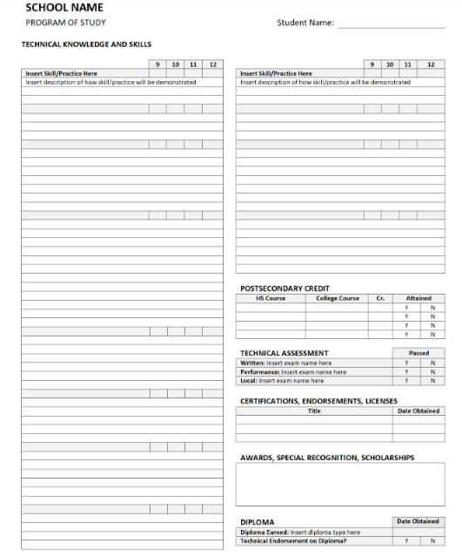

Slide 12
Articulation Agreement
Postsecondary Articulation Agreement | New York State Education Department (nysed.gov)
A formal partnership between the secondary and postsecondary institution(s) that outlines a direct benefit/s provided to students.
college credit
advance standing
reduced tuition
This agreement should be directly related to your agriculture coursework.
Examples of common post-secondary relationships include, but are not limited to:
SUNY Cobleskill
SUNY Delhi
Community Colleges
Each NYSED approved CTE program is required to have at least 1 post-secondary agreement.

Slide 13
Technical Assessment
Technical Assessment | New York State Education Department (nysed.gov)
The technical assessment is a three-part assessment consisting of:
Written examination
Student demonstration of technical skills (performance)
Student project or portfolio (locally developed)
The written and performance components of the exam must be industry developed through a third-party vendor.
NYSED does not endorse any one vendor, and vendor choice can be decided upon by the district/program.
In many currently approved CTE agriculture programs, YouScience (precision) or NOCTI are common vendors.

Slide 14
Faculty
Program Faculty | New York State Education Department (nysed.gov)
All coursework included in the NYSED approved CTE program must be taught by an appropriately certified agriculture teacher.
Certification can include a classroom or CTE specific certification that aligns to the program content in the program.
Classroom Certification Title
Agriculture (k-12)
CTE Certification Title
Agriculture Engineering and Mechanics (7-12)
Agriculture Production, Science, and Business (7-12)
Animal Science (7-12)
Natural Resources and Ecology (7-12)
Plant Science (7-12)

Slide 15
The External Review
External Review | New York State Education Department (nysed.gov)
Once the self-study process is complete, the program will then need to be presented to your external review committee for feedback and recommendations to further strengthen the program and ensure that industry alignment exists.
Business and industry stakeholders
Utilizing your advisory board or community members is a great resource!
The external team must consist of at least two business/industry partners and one post-secondary partner.

Slide 16
Submission
New applications are due October 1st
Both an electronic copy and a paper copy will need to be submitted to the CTE office. Submission information is available on our website.
This due date allows for adequate time for application review, as well as work with each program if any updates or changes need to be made.
After the review process is complete, the program can be granted NYSED CTE approval.
For new programs that submit by October 1st, 2023 and gain approval, implementation may begin in the 2024-2025 school year.
Applications for CTE Program Approval | New York State Education Department (nysed.gov)

Slide 17
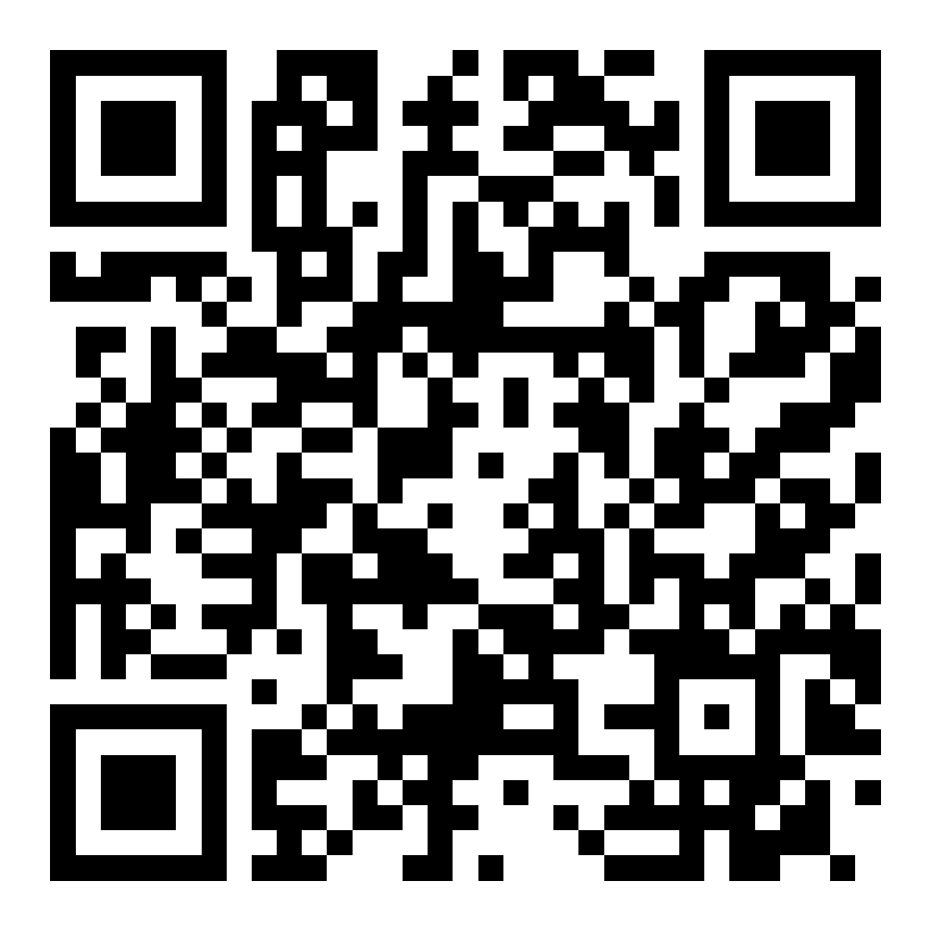
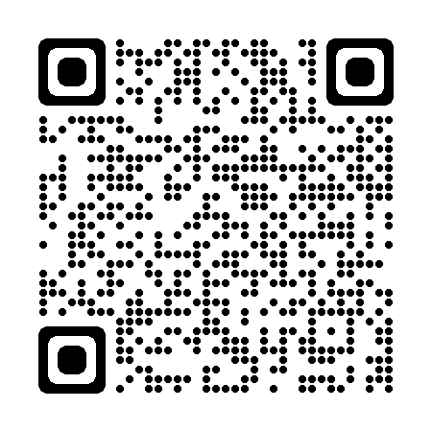
NYSED Resources
CTE Office
Kelli Grab – kelli.grab@nysed.gov
Associate in Instructional Services – Agriculture, Family and Consumer Sciences, and middle level CTE
CTE Technical Assistance Center of NY (TAC)
Field associate for each region of NY
Support in the approval process and all things NY CTE
Professional Learning Communities
All services are free of charge

Slide 18
Perkins Funding
Perkins | New York State Education Department (nysed.gov)
Contact Email : EMSCCTE@nysed.gov
School districts and BOCES who meet the necessary size, scope, and quality parameters are eligible to receive funds to support their CTE programs through the federal Carl D. Perkins grant.
Size
A minimum of three NYSED-approved CTE programs of study in three of the sixteen national career cluster areas
Each program must have a minimum of eight CTE concentrators across all grade levels enrolled
Scope
Academic and technical content alignment that is nonduplicative
Addresses academic and technical knowledge and skill, including employability skills
Aligned with the needs of industry in the economy of the state, region, or local area
Quality
Student achievement of performance targets
Programs increase in specificity
Challenging state academic learning standards and industry standards specific to each content area
Appropriate teachers’ certification and professional development
Additional information regarding Perkins funding can be found on the NYSED CTE website.

Slide 19
NYAAE and Mentorship
Jessica Devries - jdevries@uvstorm.org
Jessica is also available to support you in this process! She is also in regular contact with me regarding any questions or concerns.
Drop Box Resources
https://www.dropbox.com/sh/ij4u90vxhavvkv8/AACFIGDchpsGHLkw-i0NM6Vha?dl=0

Slide 20
Thank you! Questions?

