Slide 1
Careers In the Green Industry The Grass IS Greener on the Other Side
NYSTA’s
Apprenticeship Program

Slide 2
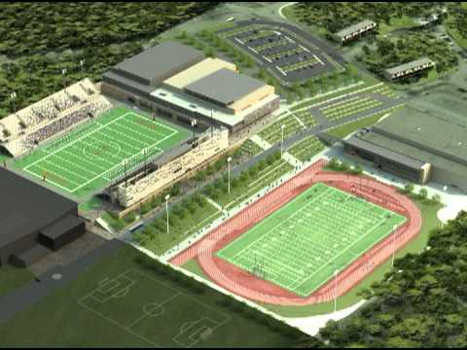
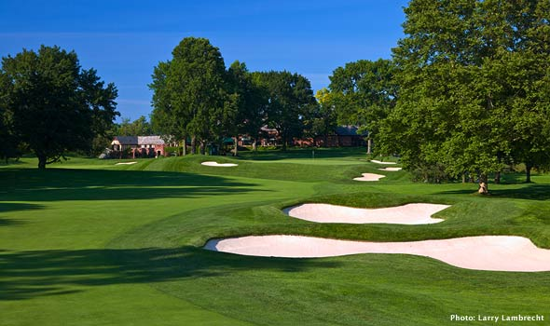
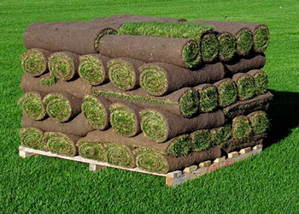
Career Fields
Golf Course Management
Sports Turf Management
Turf Equipment Technician

Slide 4
General Requirements & Preferred Attributes
Working with Plants & People
Knowledge in Plant Science, technology, basic engineering, & math
Develop strong skills in, communication, project management, personnel management, and business management.
Working in an outdoor environment
The Turf professional community has a sense of purpose, collegiality, and a genuine desire to help young people succeed, work hard and enjoy life.

Slide 5
Outlook (Bureau of Labor Statistics 2020)
Presently Over 200,000 Supervisors, Managers, etc.
Predicts in the next 10 years over 55,000 career opportunities will be created.
A much touted statistic is that nearly 99% of graduates who earn a certificate or a degree are successful in securing full time employment right out of a Apprenticship or degree program—few industries can rival that success rate!

Slide 6
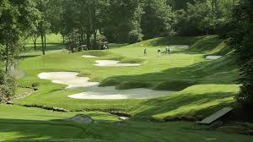
Golf Course Management
Job Description:
Deep Roots, The Life of a Golf Course Superintendent - YouTube
Degree Requirements: Minimum AAS Degree, Apprenticeship certification
Areas of Study: Plant Sciences, Horticulture, Agronomy, Business Management, Hydraulics
Internship or Apprenticeship
The average base salary for Assistant course superintendents rose to $60,189, a 4.7% increase (2021)
The average base salary for certified golf course superintendents rose to $109,620, a 5.4% increase (2021)
Professional Associations: Golf Course Superintendents Association (GCSAA)

Slide 7
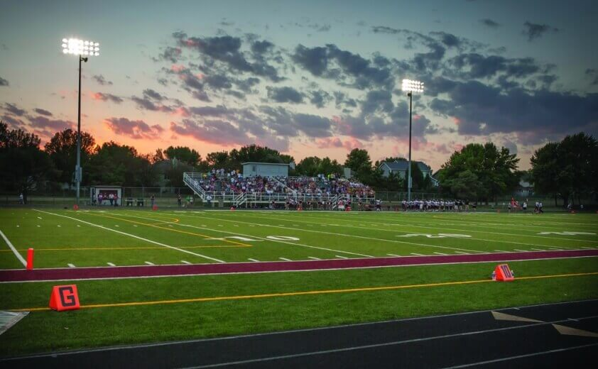
Sports Turf Management
Job Description: Spotlight On: It's the FIELD! - YouTube
Degree Requirements: Minimum Apprenticeship Certification & AAS Degree
Areas of Study: Plant Sciences, Horticulture, Agronomy, Business Management
Internship or Apprenticeship Requirement
Mean Salary (2020) = $65,500
Professional Associations: Sports Turf Management Association (STMA)

Slide 8
Turf Equipment Technician
Job Description:
Inspect, diagnose, adjust, and repair mechanical defects/failures in various golf course maintenance equipment
Prioritize equipment repair and pm services
Set up and modify new equipment as needed
Repair and adjust engines and cutting mechanisms on various mowing equipment
Spot check equipment for performance on the course and make emergency repairs as necessary
Properly recycle and dispose of various oils, anti-freeze and filters
Oversee and maintain a clean service area emphasizing safety

Slide 9
Requirements: Apprenticeship Certification Areas of Study: Hydraulics, Engine Diagnosis, Welding, Mechanical repair, Preventive maintenance, Sharping & grinding, Electrical Diagnostics Internship &/or Apprenticeship Certificate Mean Salary: Average/Mean = $25- $35/hr. or $35,000-$65,000/yr. (2020)

